Slide 1
OR Gate
A | B | A OR B
0 | 0 | 0
0 | 1 | 1
1 | 0 | 1
1 | 1 | 1

Slide 2

OR GATE
0
1
0
1
0
0
0
1
1
1
1
1

Slide 3
AND GATE
A | B | A AND B
0 | 0 | 0
0 | 1 | 0
1 | 0 | 0
1 | 1 | 1

Slide 4
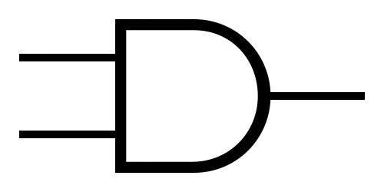
AND GATE
0
1
0
0
0
0
1
0
1
0
1
1

Slide 5
XOR GATE
A | B | A XOR B
0 | 0 | 0
0 | 1 | 1
1 | 0 | 1
1 | 1 | 0

Slide 6

XOR GATE
0
1
0
1
0
0
1
0
0
1
1
1

